Slide 1

bot
Beini Wang, Frank Anderson, Jack Turner, & Rahul Suresh
CS 5100 - Foundations of AI

Slide 2
Agenda
1
Problem
2
Approach
3
Modeling
4
Training
5
Demo
6
Results
7
Q&A

Slide 3
Agenda
1
Problem
2
Approach
3
Modeling
4
Training
5
Demo
6
Results
7
Q&A

Slide 4
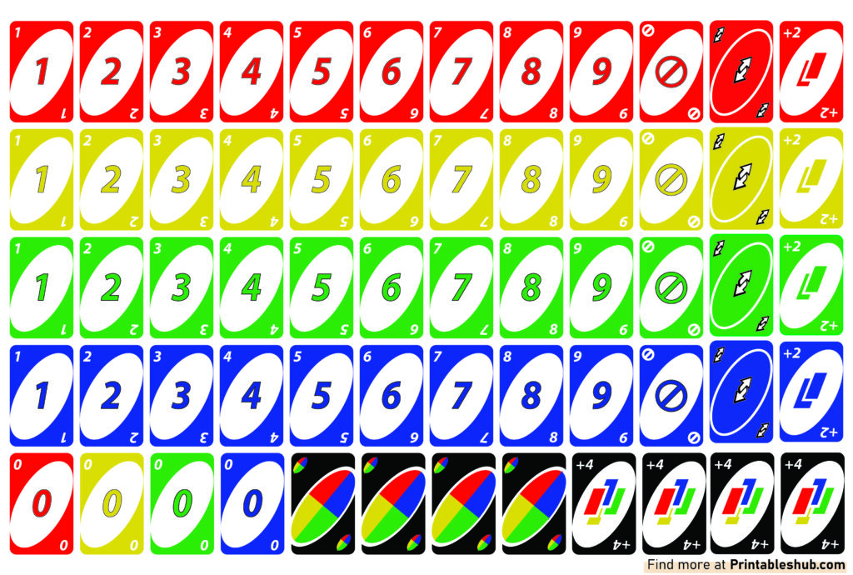
Our goal: Train an AI to master Uno!
Uno! is the card game where players compete against each other to be the first to run out of their cards.
We want to build a robot which reliably beats a Random player.

Slide 5
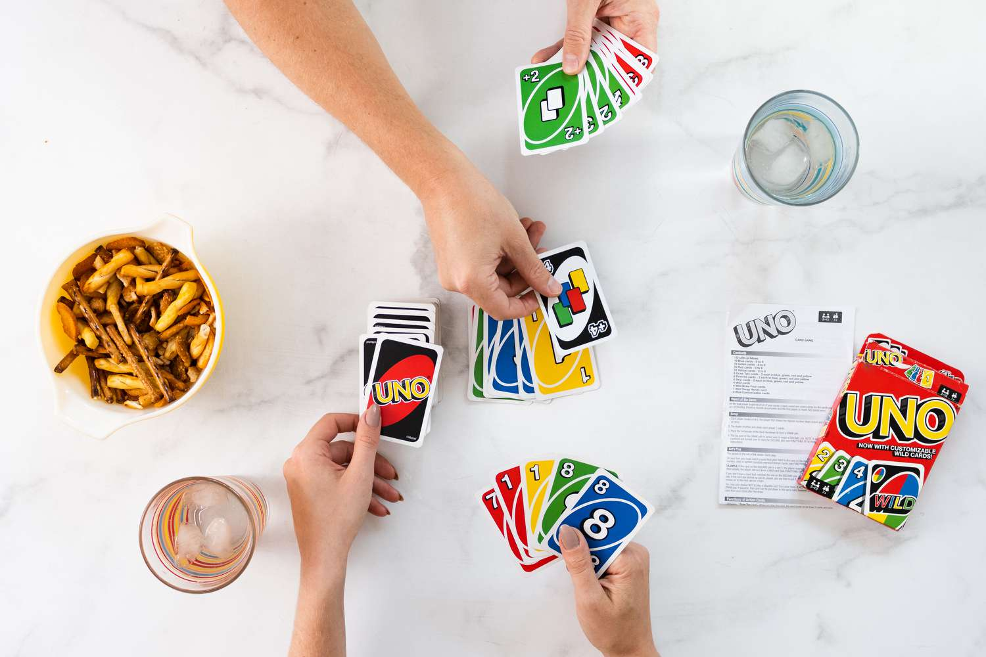
How to play
Players play a card from their hand with a matching color or number to the current card.
If a player does not have a valid card, they draw one then play moves to the next player.
Players continue until one player has run out of their cards and is deemed the winner!

Slide 6
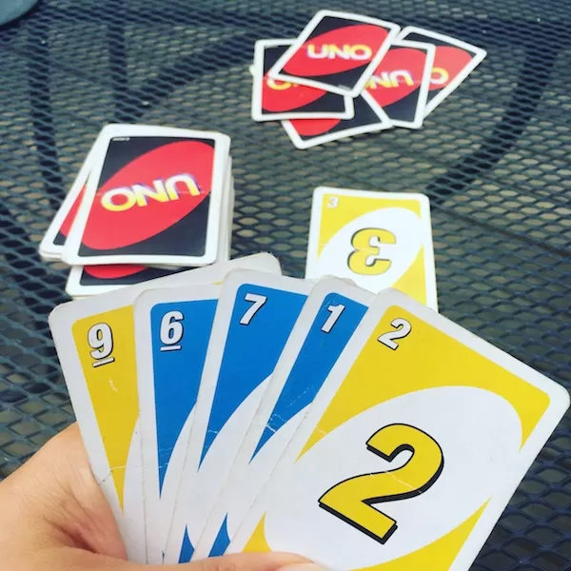
Considerations
Partially observable:
Known current card
Known hand
Unknown opponent hands
Forced to perform certain moves in many conditions
Only one valid move / must draw a card

Slide 7
Agenda
1
Problem
2
Approach
3
Modeling
4
Training
5
Demo
6
Results
7
Q&A

Slide 8
Analysis of potential approaches
Genetic Algorithm
Reinforcement Learning
Assign point values for each card played. Play the most valuable card at any moment
For a given State, take the perceived best action to move towards a Win
Assumes playing a Wild/Skip/Draw is more valuable than playing a normal card
Ignores timing of when to play the most powerful cards
Accounts for timing of when to play cards
Much longer to train, so highly dependent on choosing the right modeling method
↖️ Chosen Approach

Slide 9





Code: Game Setup
Use existing object-oriented Uno! game
Replace the Human player with our AI agent
Update the Uno Game to enable sharing observations with our AI agent

Slide 10
Agenda
1
Problem
2
Approach
3
Modeling
4
Training
5
Demo
6
Results
7
Q&A

Slide 11
How to model the State space was a careful balance of priorities
Too much fidelity in the model = impossible training time requirement
↕️ balance
Too little fidelity in the model = insignificant result

Slide 12
Key unlocks in modeling
Tracking the player’s hand
Tracking opponents
What cards are in the current hand?
108 cards in the deck + how do you hash that?
What cards have been played so far?
Infinite max size + how do you has that?
⬇️
⬇️
How many playable cards with the same number or same color?
Up to 10 matching per number, 20 matching per color
How many cards does each opponent have left?
Limited useful bounds, pick a cap?
The last card each drew for?
Up to 4 possible colors, 10 numbers

Slide 13
“Wishful Thinking” Modeling
What if we captured the full bounds of any relevant data?
Agent | Possibilities
Same number? | 11
Same color? | 21
Draw 2? | 3
Wild? | 5
Skip? | 3
Reverse | 3
Player 1 | Possibilities
P1 Hand Size | 109
P1 Last Number | 10
P1 Last Color | 4
> 1 trillion
possible
states
Player 2 | Possibilities
P2 Hand Size | 109
P2 Last Number | 10
P2 Last Color | 4
Game | Possibilities
Direction of play | 2

Slide 14
“Clamped” Modeling
What if we limit the bounds as much as possible?
Agent | Possibilities
Same number? | [0, 1] (2)
Same color? | [0, 1, 2] (3)
Draw 2? | [0, 1] (2)
Wild? | [0, 1] (2)
Skip? | [0, 1] (2)
Reverse | [0, 1] (2)
Next Player | Possibilities
Uno? | [0, 1] (2)
Last Color | [0, 1, 2, 3] (4)
6,144
possible
states
Next Next Player | Possibilities
Uno? | [0, 1] (2)
Last Color | [0, 1, 2, 3] (4)

Slide 15
The action space was also optimized
Ideal action space
Optimized action space
“Play this specific card from the hand”
“Play either a matching number, color, or a skip, reverse, wild, draw 2, or draw 4”
4 colors x (10 numbers + 3 action cards) + 1 wild + 1 draw 4 = 54 actions
= 7 actions

Slide 16
Finally, we’re able to build the Q table
Q Table | States: #, Color, +2, Skip, Reverse, Wild, +4, P1 #, P1 Color, P2 #, P2 Color
Actions: Match Number Match Color +2 Skip Reverse +4 Wild | Training for 43k cells … ➡️

Slide 17
Agenda
1
Problem
2
Approach
3
Modeling
4
Training
5
Demo
6
Results
7
Q&A

Slide 18


Code: Training Setup
Run many iterations of Uno! games to populate and update the Q table
Apply Epsilon Greedy to shift from random moves to optimal moves throughout training

Slide 19
Agenda
1
Problem
2
Approach
3
Modeling
4
Training
5
Demo
6
Results
7
Q&A

Slide 21
Agenda
1
Problem
2
Approach
3
Modeling
4
Training
5
Demo
6
Results
7
Q&A

Slide 23
Q&A

